Slide 1
From Machine Learning to Deep Learning – Research and Applications
Zengchang Qin (Ph.D.)
http://dsd.future-lab.cn

Slide 2
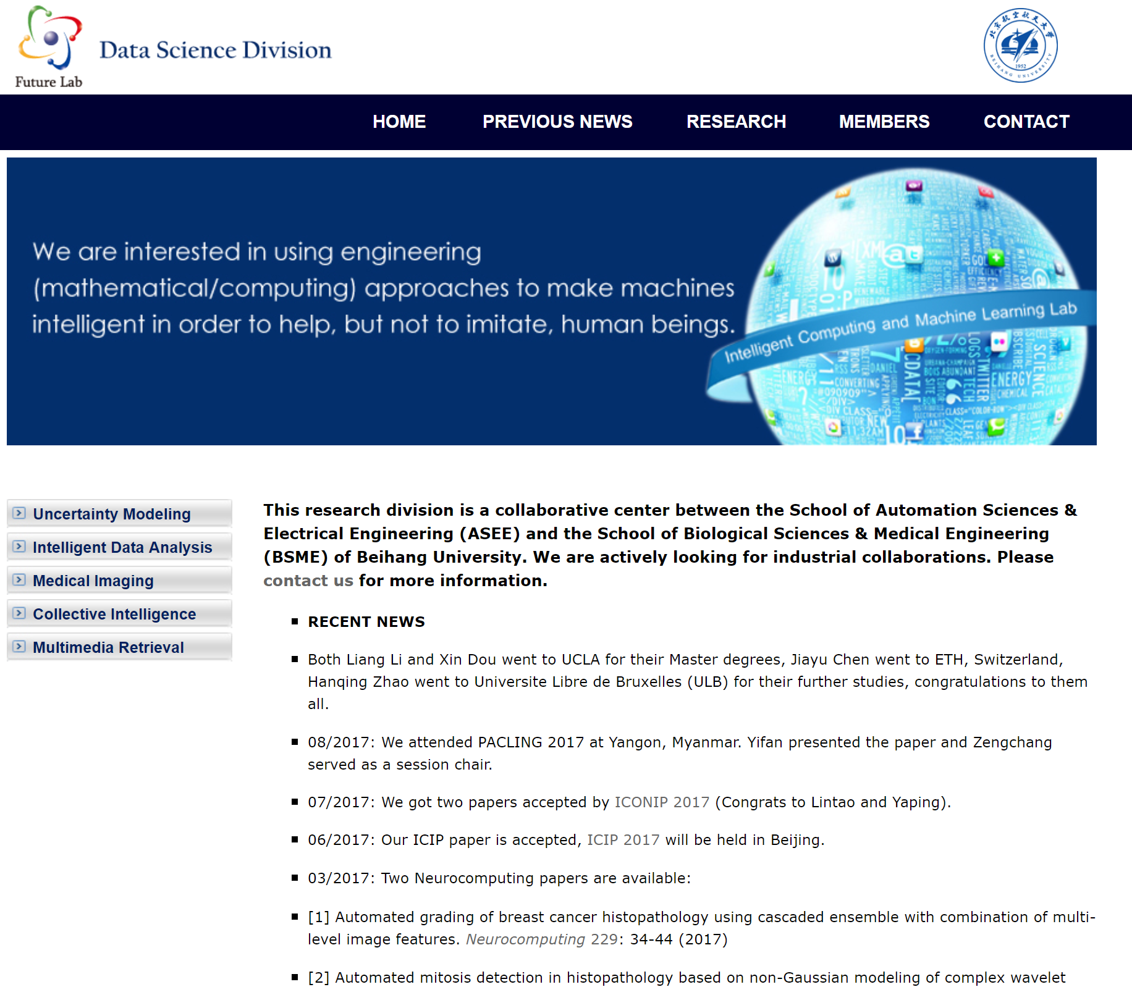
Overview
Artificial Intelligence
Philosophy of A.I.
What is Machine Learning?
Generative vs Discriminative?
Is Deep Learning New？
Multimedia Retrieval
Audio and Music
Image Translation
Natural Language Processing.
Social Networks
A.I. in Medical

Slide 3


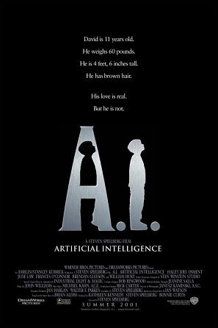

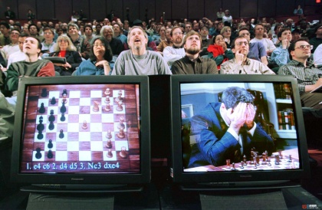
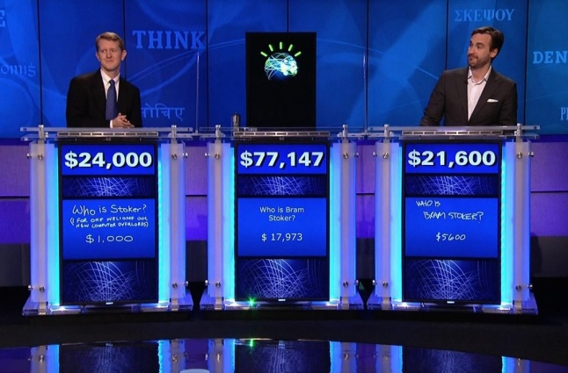
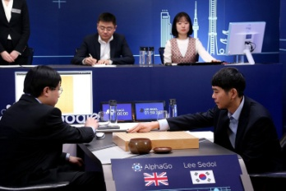
Artificial Intelligence
From popular culture: A.I. ≈ Robot
Situation is changing, we have virtual A.I. in popular culture.
Deep Blue: Chess Player
Watson: Question Answerer
AlphaGo: Go Player

Slide 4
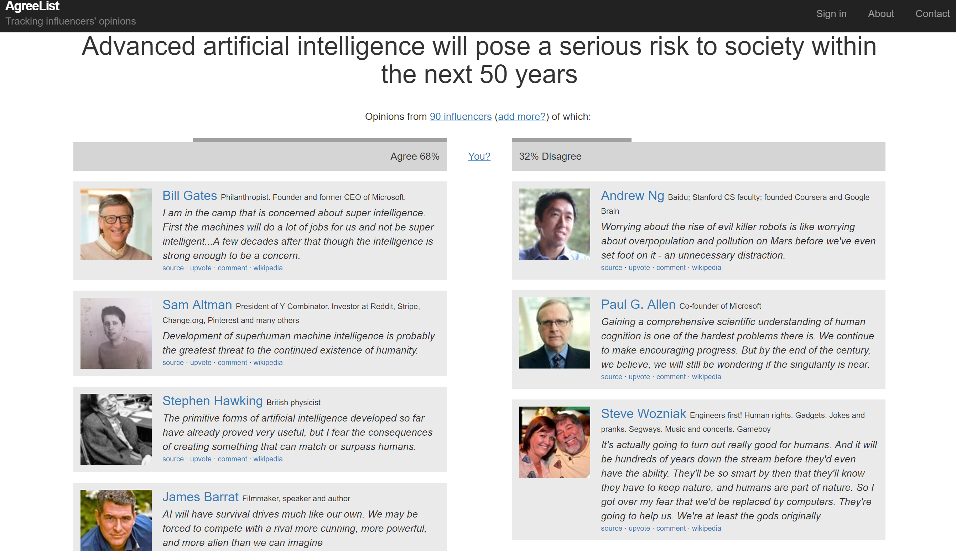
What Other People Say?
http://www.agreelist.org/a/artificial-intelligence-risk

Slide 5
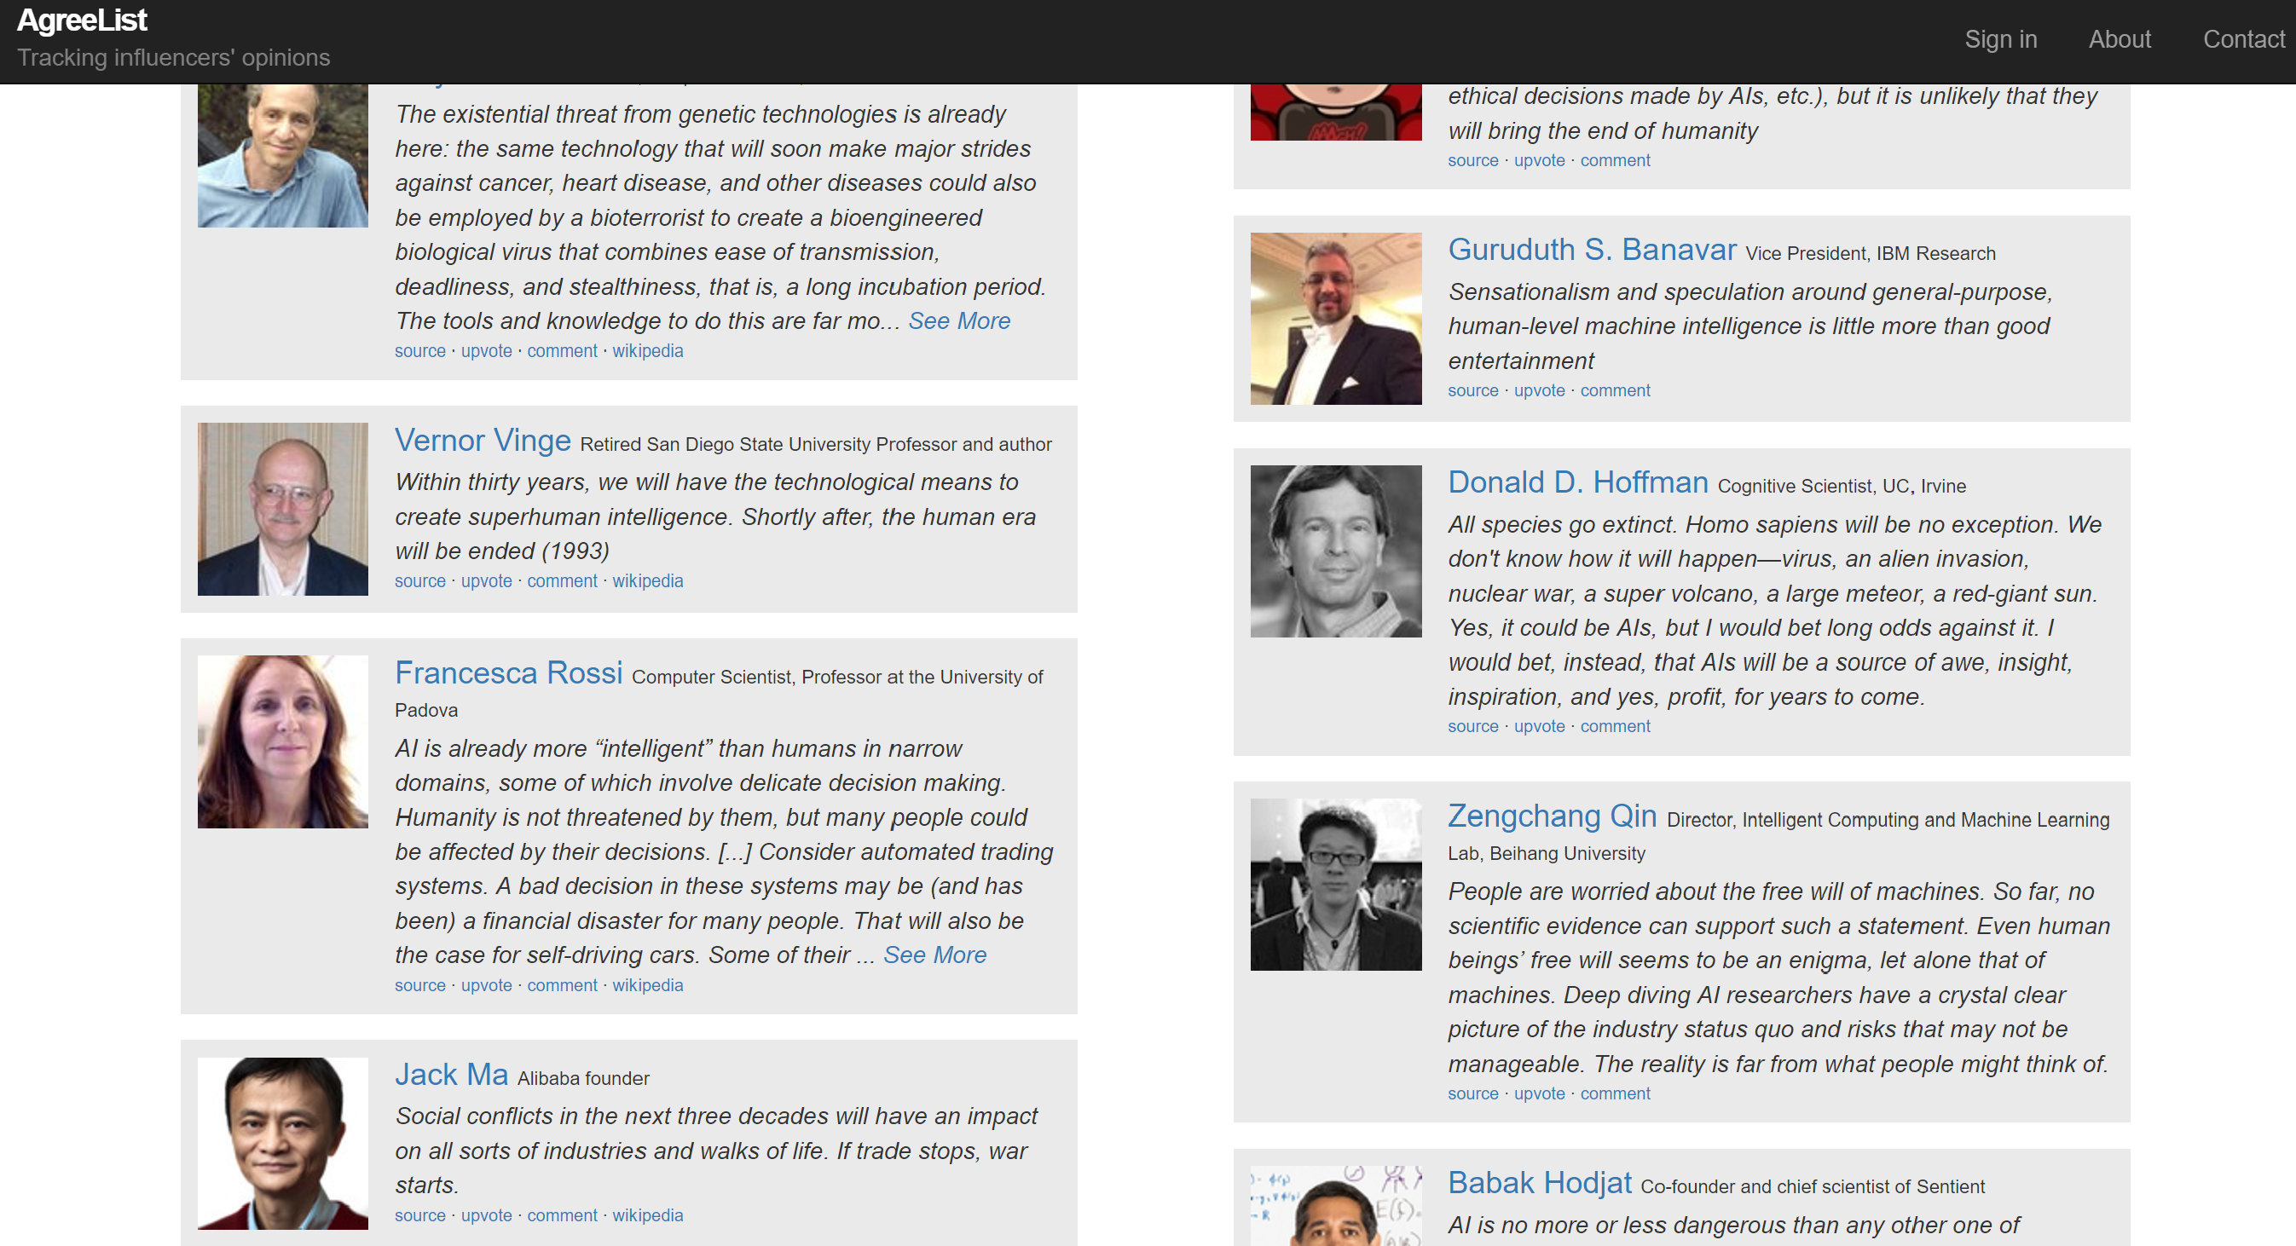
I Disagree, alone with M. Zuckerberg and R. Brooks

Slide 6


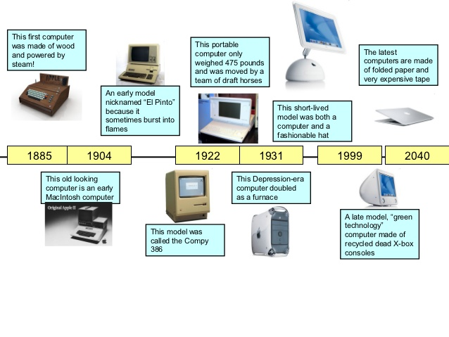
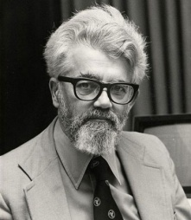
Development of A.I.

Slide 7
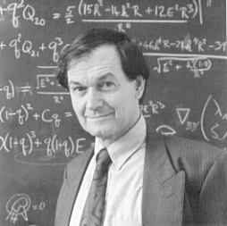
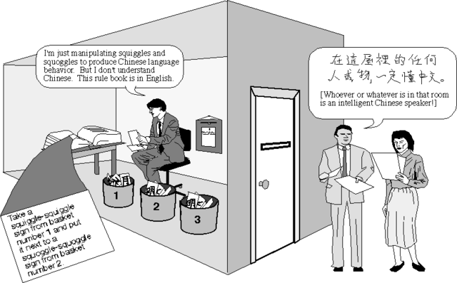
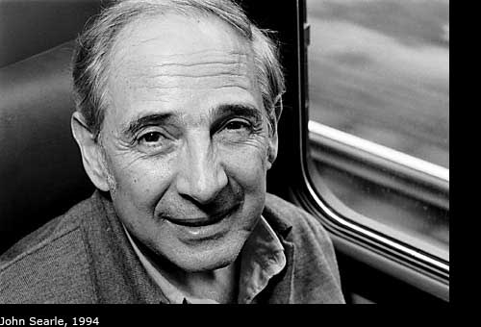
Philosophy of A.I.
Artificial Intelligence (AI) is a mathematical/computing technology that will make life better.
I have been interested in making machines intelligent by designing algorithms.
I may not believe that one day we can recreate human brains using silicon chips, but I believe that computing will aid our brains to do missions impossible in the future.

Slide 8
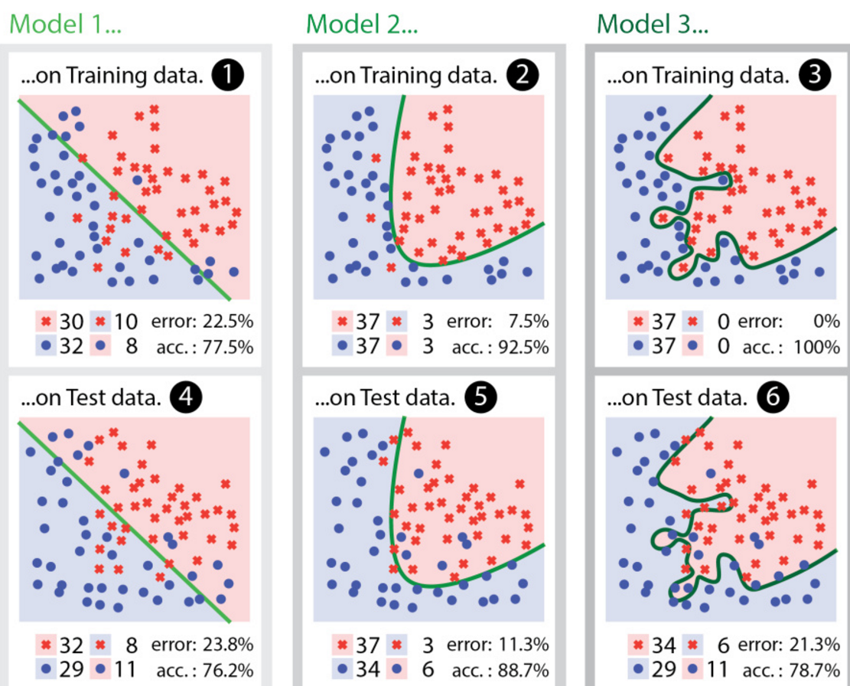
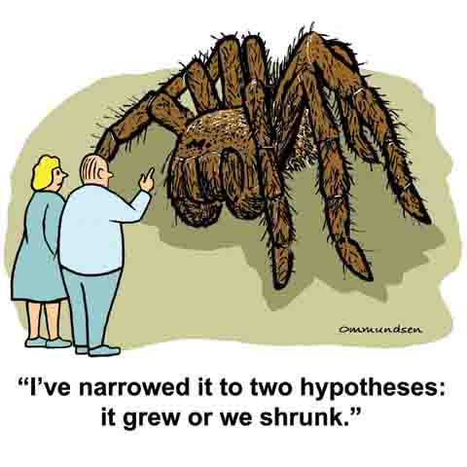
What is Machine Learning?
■ A tradeoff between generalization and specification. (E.g, there is no two leave are exactly the same, or all greens are leaves. )

Slide 9
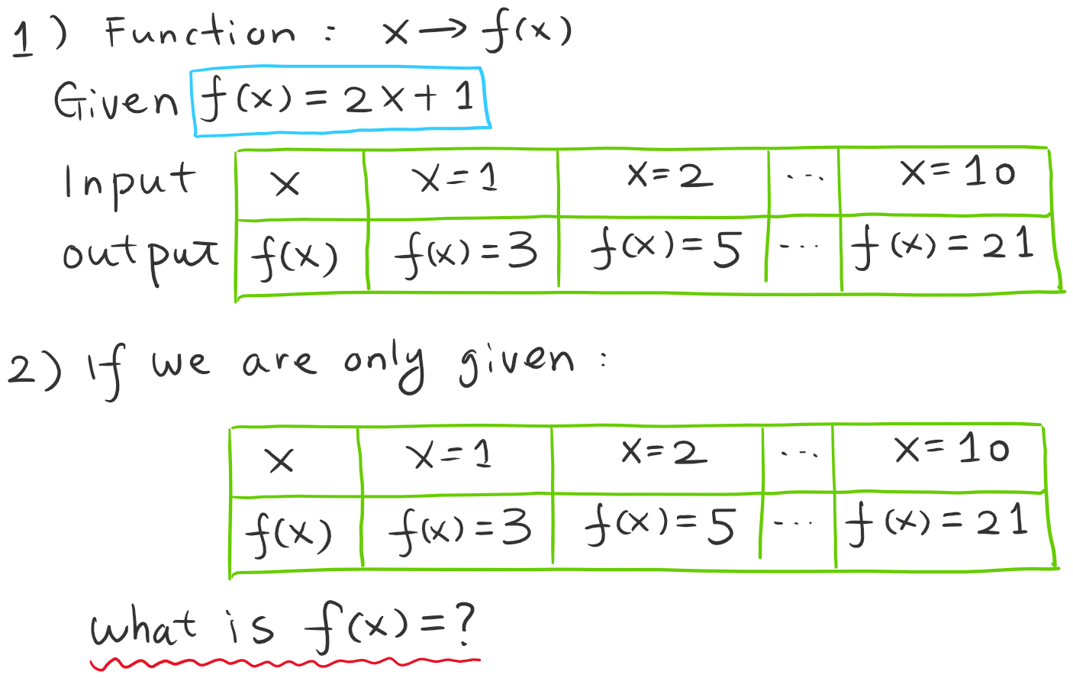
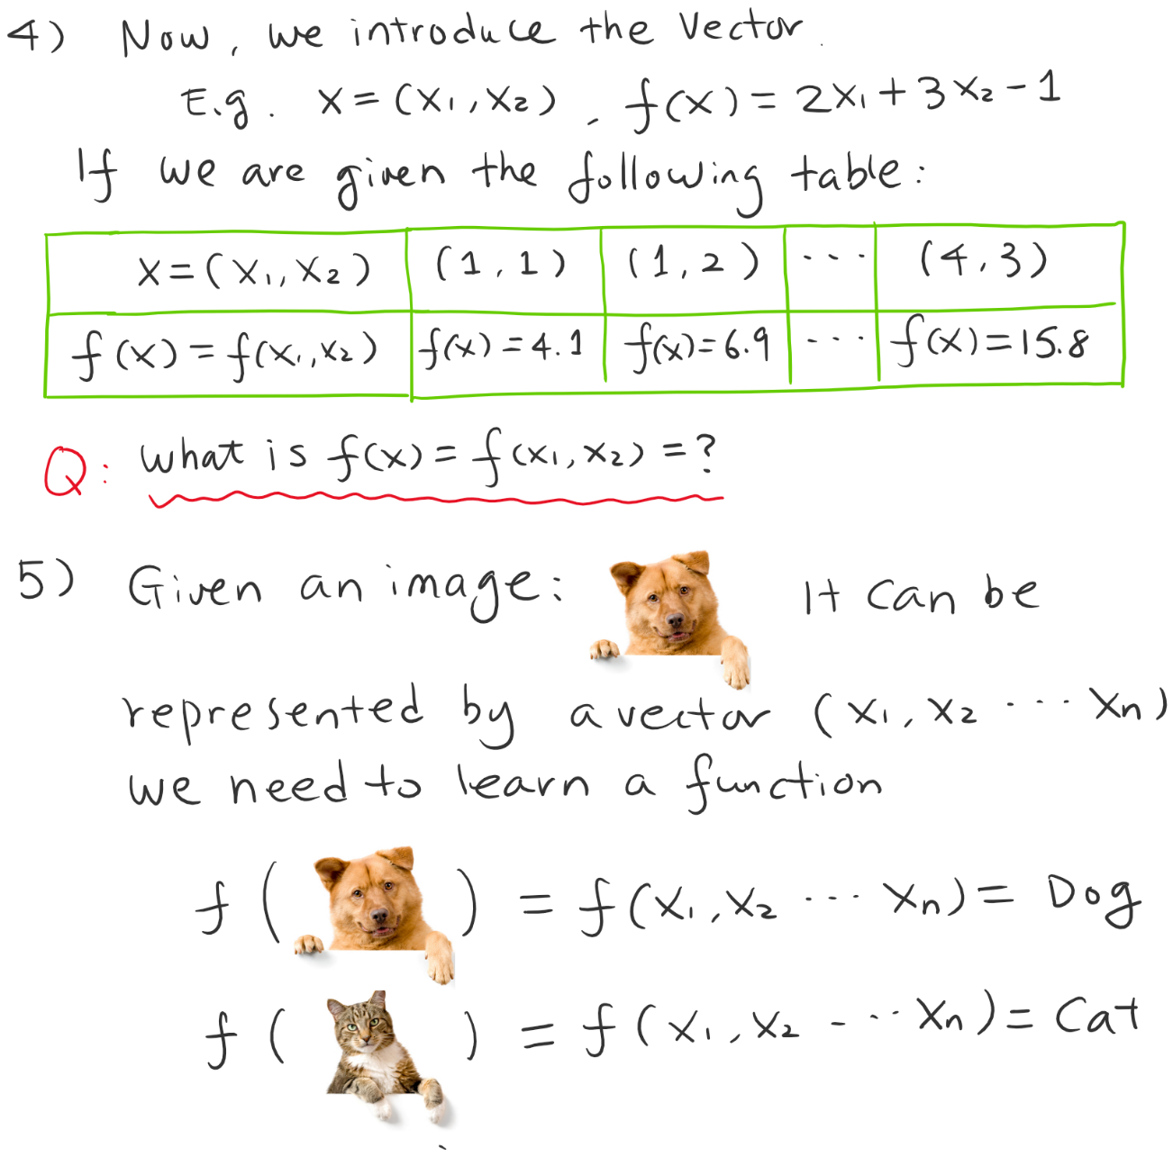
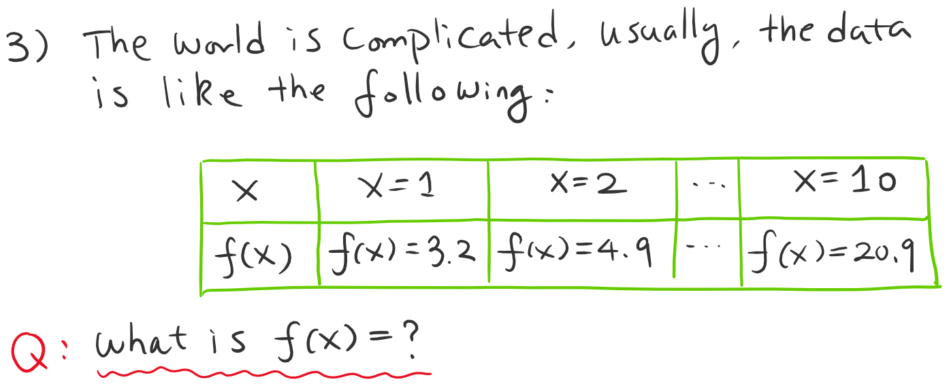
What is Machine Learning?

Slide 10
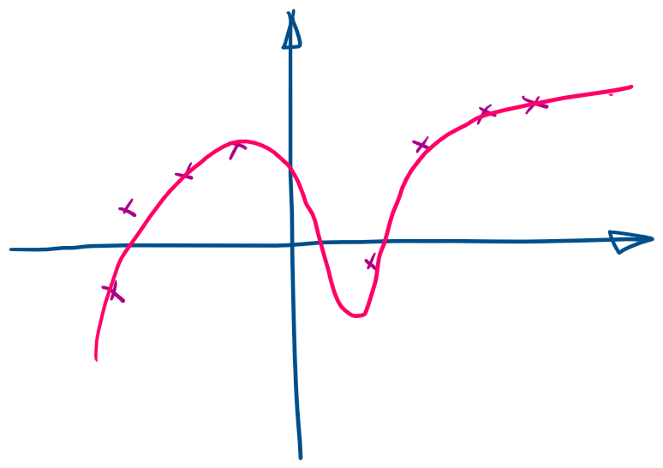
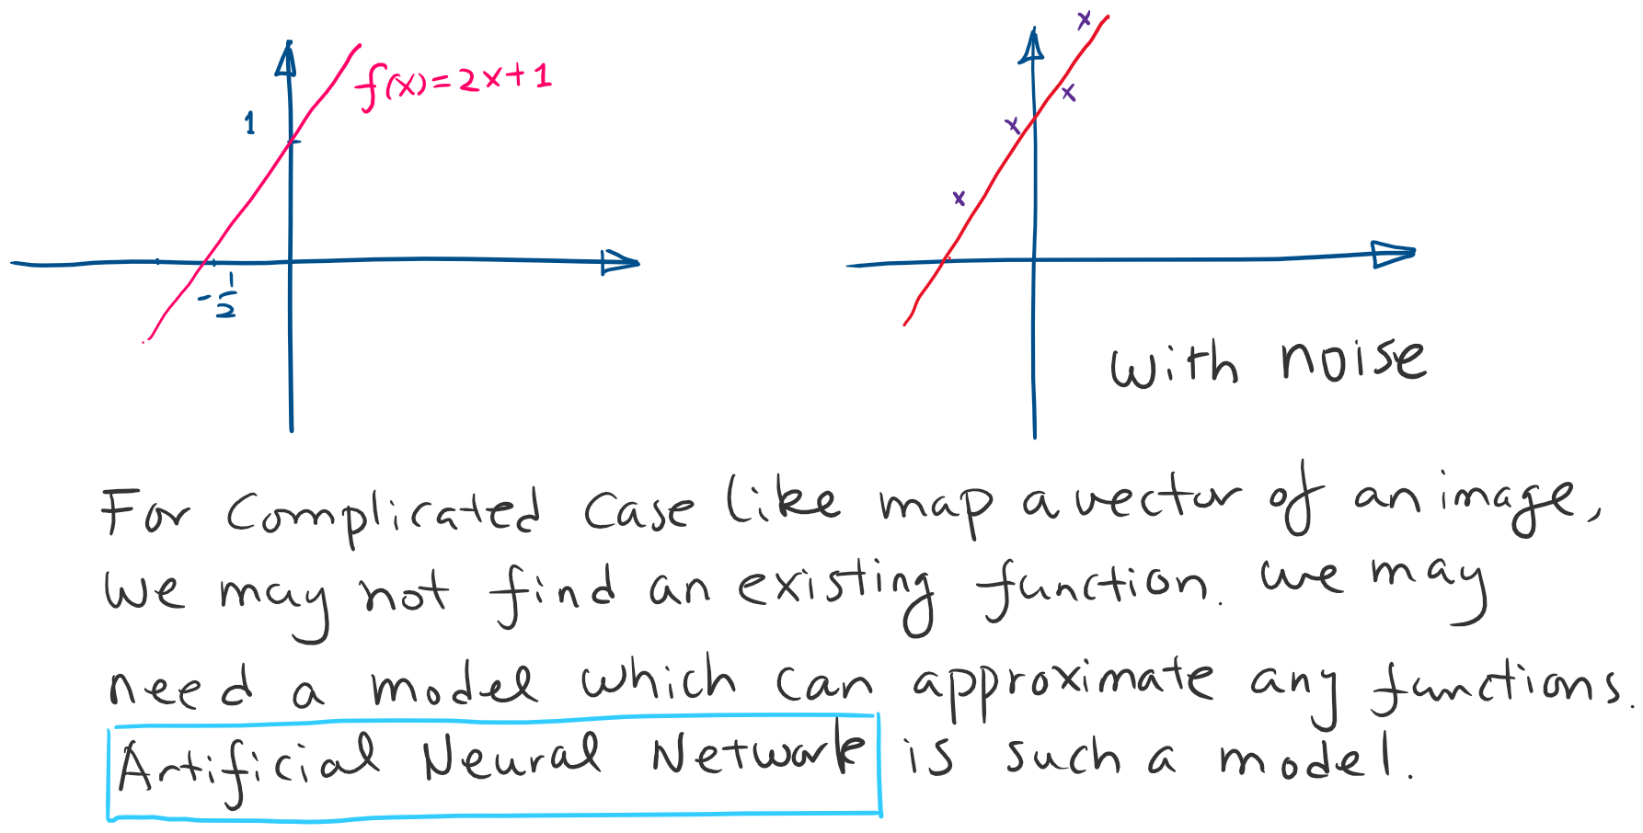
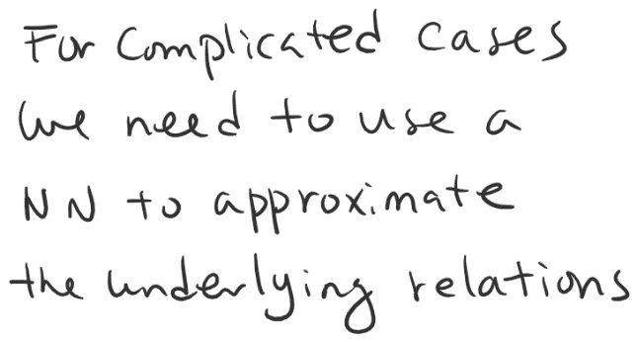
What is Machine Learning?

Slide 11
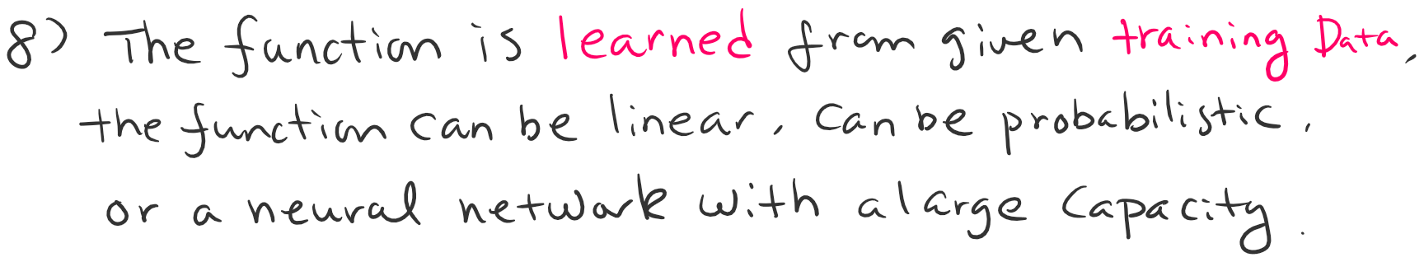
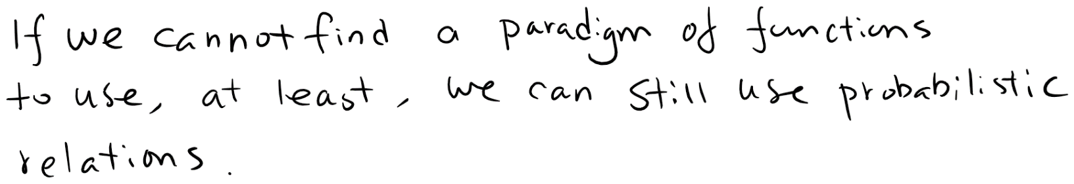
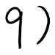
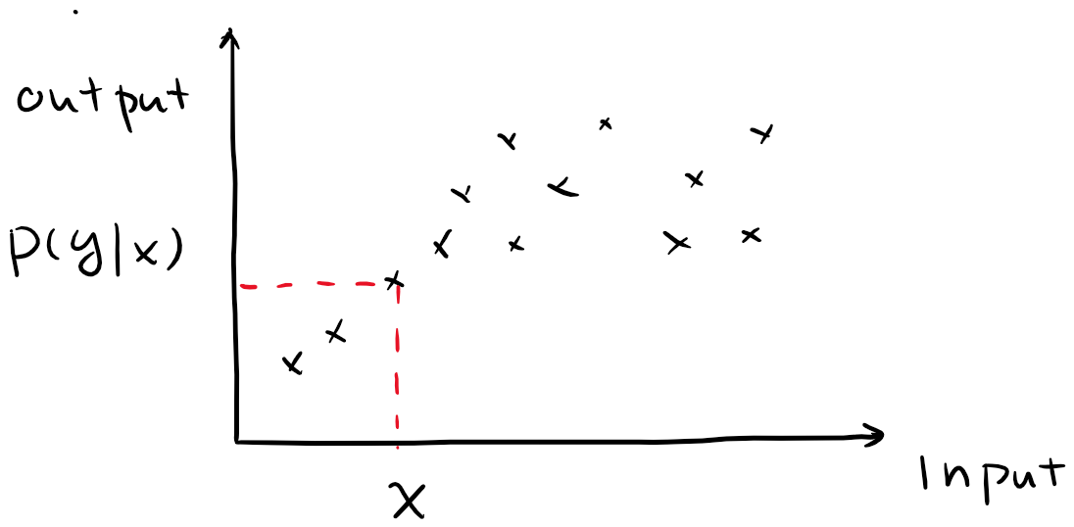
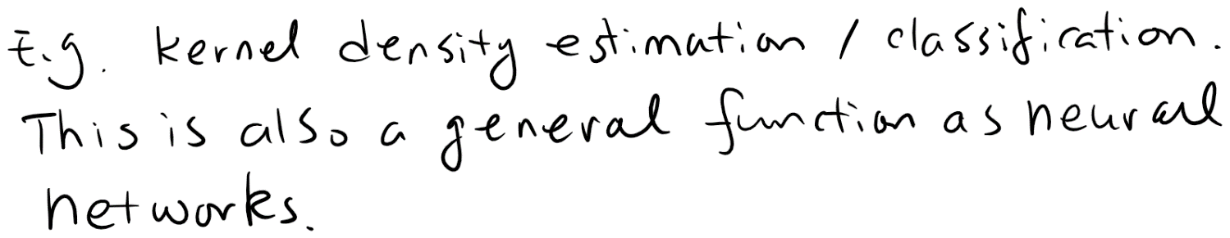
What is Machine Learning?

Slide 12
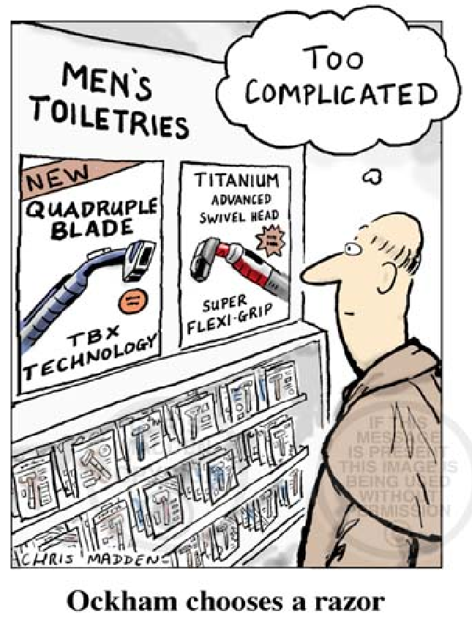
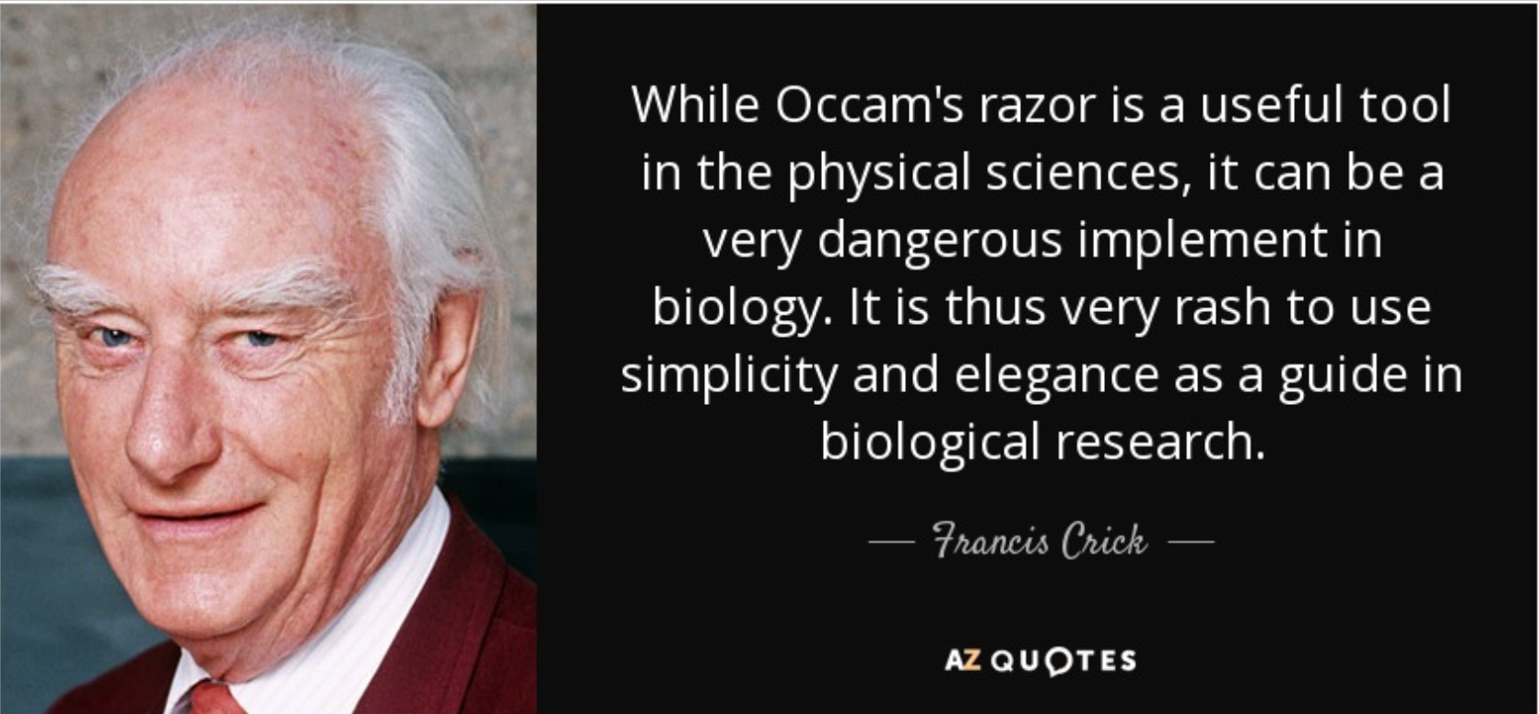
Occam’s Razor and Overfitting
■ Occam's razor (or Ockham's razor) is a principle from philosophy. Suppose there exist two explanations for an occurrence. In this case, the simpler one is usually better.
Q: Any other examples of Occam’s Razor？

Slide 13
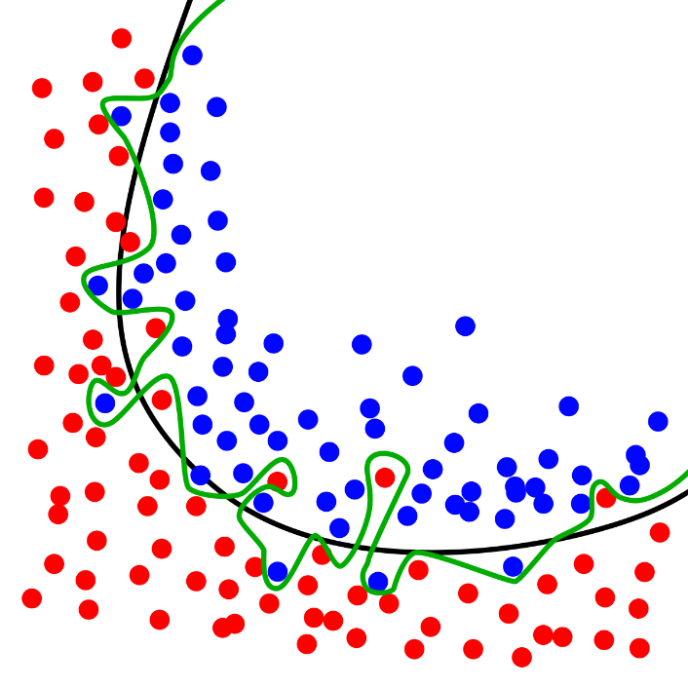


Overfitting
■ Let's say you attend a symphony and want to get the clearest, most faithful sound possible. So you buy a super-sensitive microphone and hearing aid to pick up all the sounds in the auditorium.
■ Then you start "overfitting," hearing the noise on top of the symphony. You hear your neighbors shuffling in their seats, the musicians turning their pages, and even the swishing of the conductor's coat jacket.
■ In machine learning, we tends to favor simple models. When two models that make exactly the same predictions, the simpler one is the better. If the model is too complex, we may face the problem of overfitting.
Q: Any other examples of overfitting？
Notes:
Let's say you attend a symphony and want to get the clearest, most faithful sound possible. So you buy a super-sensitive microphone and hearing aid to pick up all the sounds in the auditorium. Then you start "overfitting," hearing the noise on top of the symphony. You hear your neighbors shuffling in their seats, the musicians turning their pages, and even the swishing of the conductor's coat jacket. When you're at a concert, there's both the symphony and the random noise. Fitting a perfect model is only listening to the symphony. Over-fitting is when you hear more noise then you need to, or worse, letting the noise drown out the symphony.

Slide 14
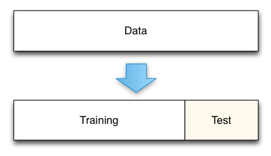
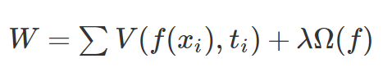
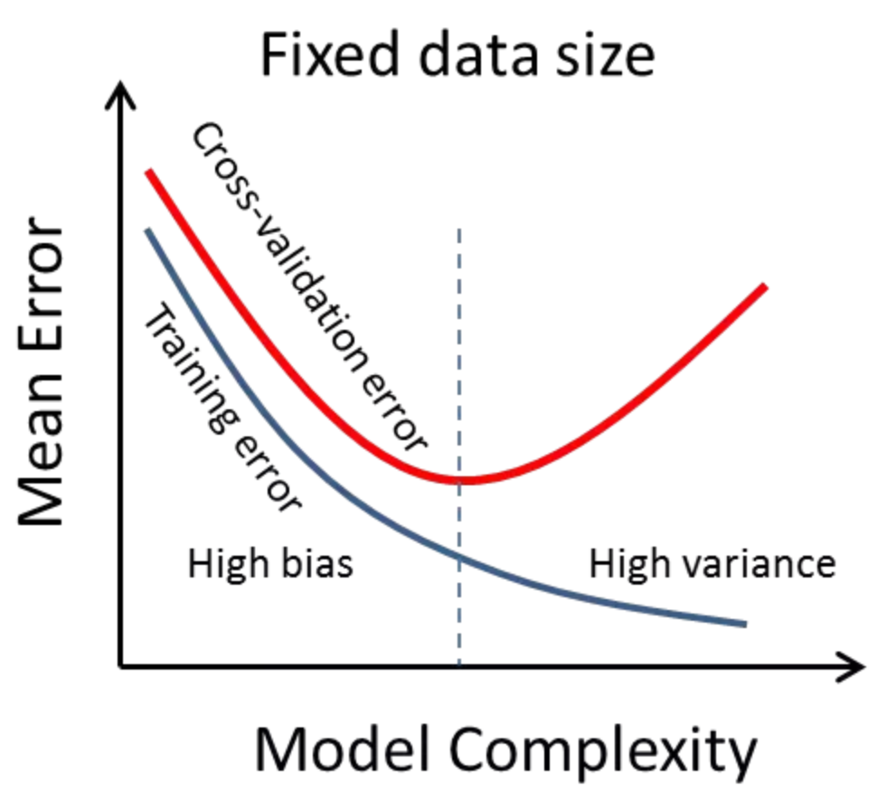
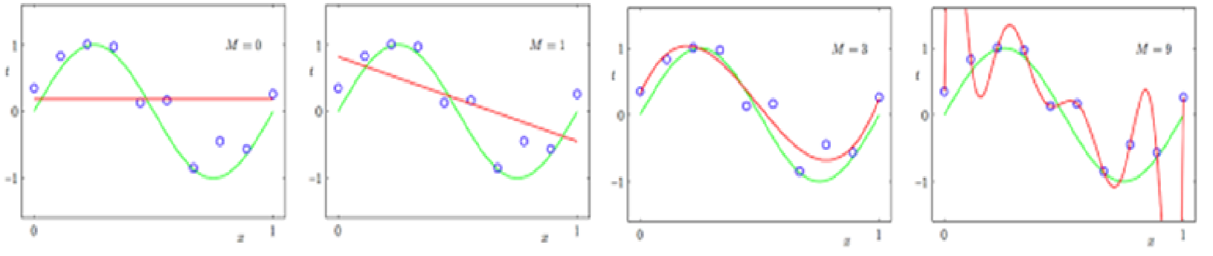
Avoid Overfitting
In short, the general strategies are to
Collect more data
Use ensembling methods that “average” models
Regularization to penalize complexity
N-fold cross-validation

Slide 15
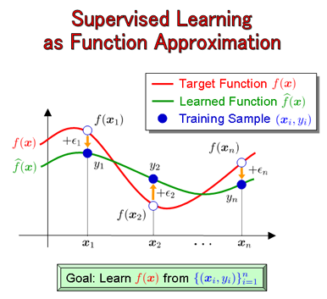
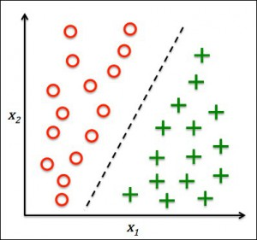
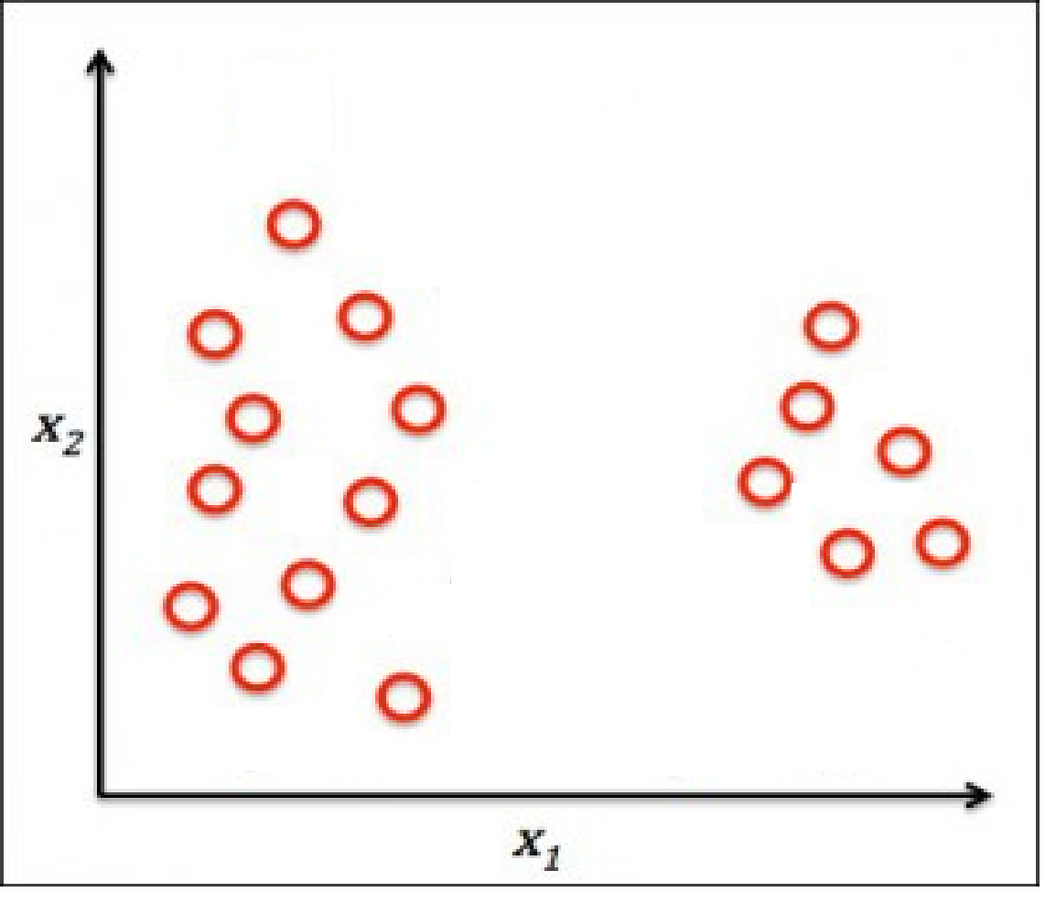
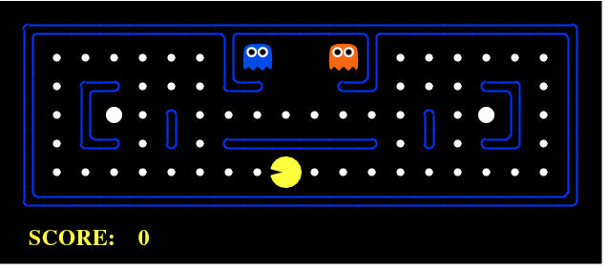
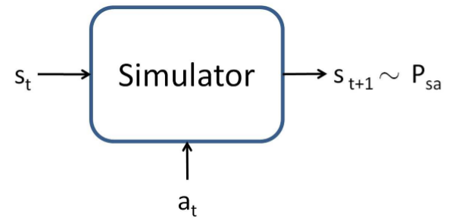
Paradigm of Machine Learning
Supervised Learning
as classification
Unsupervised Learning
Reinforcement
Learning

Slide 16
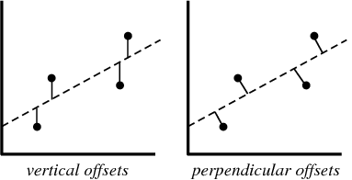
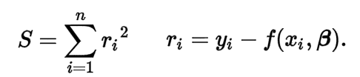
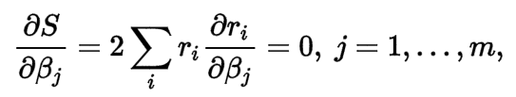
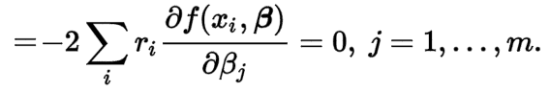
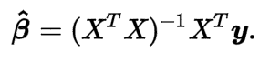
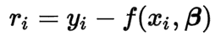

Discriminative - Least Square Fitting
A mathematical procedure for finding the best-fitting curve to a given set of points by minimizing the sum of the squares of the offsets.
Solving the least squares problem:
Residuals are the vertical distances between the data points and the corresponding predicted values.
since

Slide 17
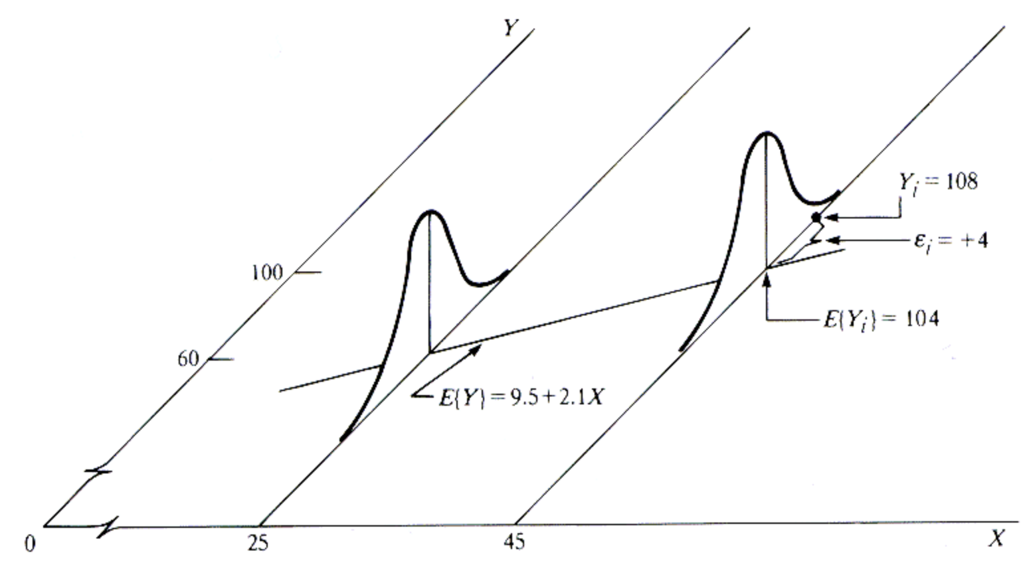
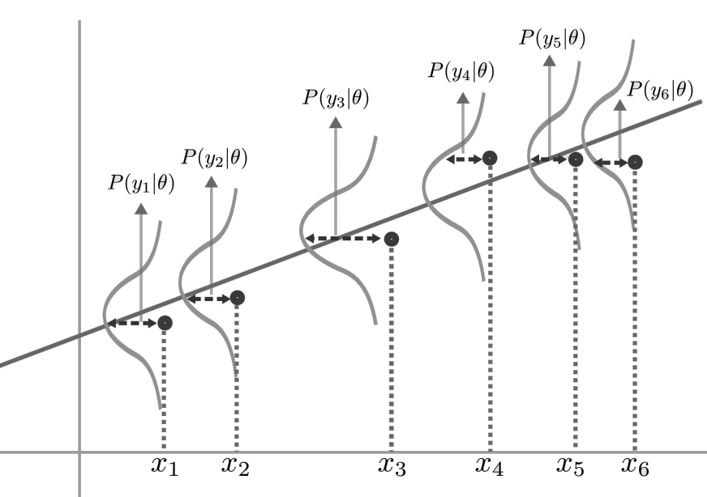
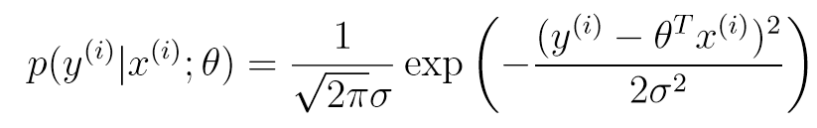
Maximum Likelihood - Generative
It implies that:
■ When we wish to explicitly view this as a function of $θ$, we will instead call it the likelihood function:

Slide 18
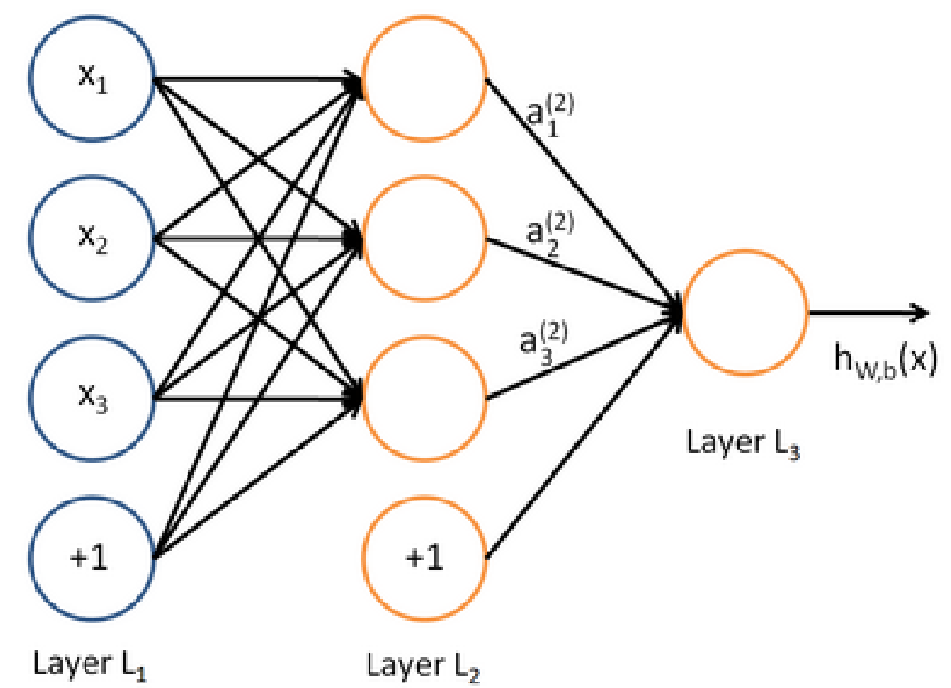
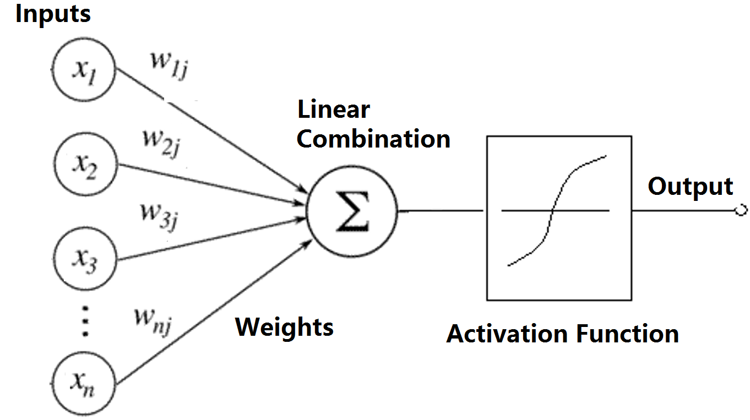
NN and LR
A neural network = running several logistic regressions at the same time.
The LRs are then feed into another logistic regression function.

Slide 19

Convolutional Neural Networks
In Image Classification a CNN may learn to detect edges from raw pixels in the first layer, then use the edges to detect simple shapes in the second layer, and then use these shapes to deter higher-level features, such as facial shapes in higher layers. The last layer is then a classifier that uses these high-level features.

Slide 20

Long-Term Dependency
Consider trying to predict the last word in the text “I grew up in France… I speak fluent French.” Recent information suggests that the next word is probably the name of a language, but if we want to narrow down which language, we need the context of France, from further back. It’s entirely possible for the gap between the relevant information and the point where it is needed to become very large.

Slide 21


LSTM – Long Short-Term Memory
Standard RNN
LSTM
Hochreiter S, Schmidhuber J. Long short-term memory[M], Supervised Sequence Labelling with Recurrent Neural Networks. Springer Berlin Heidelberg, 1997:1735-1780.

Slide 22
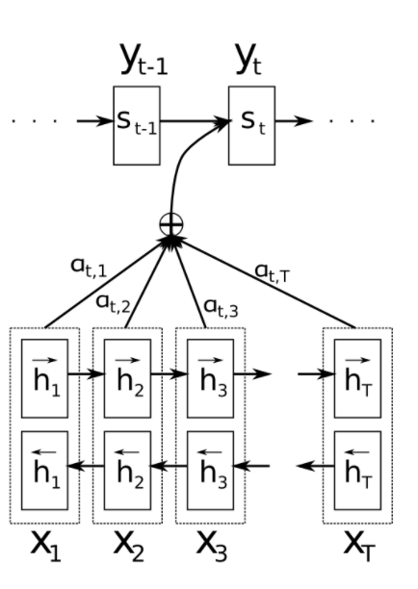
Attention Mechanism
Input sequence -> fixed-sized vector -> target sequence.
LSTM/GRU can learn problems with long range temporal dependencies.
The important part is that each decoder output word y now depends on a weighted combination of all the input states, not just the last state.

Slide 23
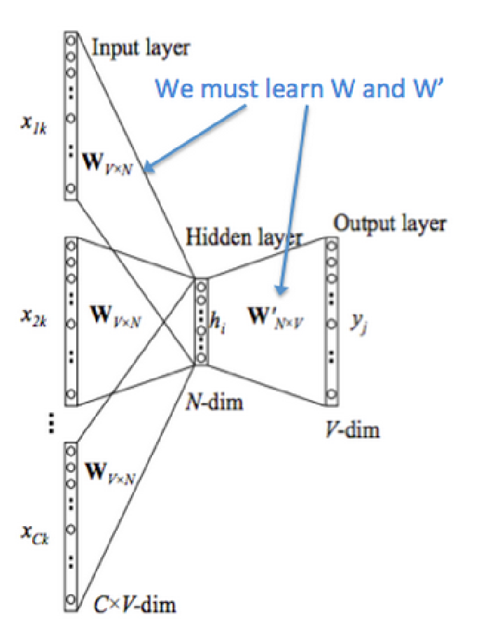



Neural Language Model - CBOW

Slide 24



Sound and Music Retrieval
Zengchang Qin, Wei Liu and Tao Wan (2013), A bag-of-tones model with MFCC features for musical genre classification, (ADMA 2013), pp. 564-575.
Hanqing Zhao, Zengchang Qin (2014)，TuneRank model for main melody extraction form multi-part musical scores，(IHMSC 2014), pp. 176-180.
Hanqing Zhao, Zengchang Qin, Yiyu Wang and Yuxiao Wang (2015)，A Bag-of-phonemes Model for homeplace classification of Mandarin speakers，Iberian Conf. on Pattern Recognition and Image Analysis (IbPRIA 2015), LNCS 9117, pp. 683-690.

Slide 25





Computer Vision
We have some successful trail on traditional computer vision tasks, such as super-resolution, semantic segmentation and object detection. Now, we focus on the deep learning for computer vision.
Renjie Liao, Zengchang Qin (2013),Image super-resolution using local learnable kernel regression,(ACCV 2012), Part III, LNCS 7726, pp. 349-360.
Xu Liu, Zengchang Qin, Xiaofan Zhang and Tao Wan (2013),Color saliency model based on mean shift segmentation,(ICASSP 2013), pp. 2104-2108
Chuang Gan, Zengchang Qin, Jia Xu and Tao Wan (2013), Salient object detection in image sequences via spatial-temporal cue,(VCIP 2013), pp. 1-5.

Slide 26


Multimedia Retrieval
Cong, Y., Qin, Z., Yu, J., & Wan, T. (2012). Cross-modal information retrieval – a case study on chinese wikipedia. Lecture Notes in Computer Science, 7713, 15-26.

Slide 27


Multimedia Retrieval
Qin, Z., Wan, T., & Zhang, W. (2012). Semi-automatic image annotation using sparse coding. ICMLC.
Qin, Z., Wan, T., Yu, J., & Zhang, X. (2013). Feature integration analysis of bag-of-features model for image retrieval. Neurocomputing, 120, 355-364.

Slide 28




Sentiment Analysis
Sentiment weights of Mixed-gram Terms
Sentimental Representations for Mixed-gram Terms
We employ statistical learning and deep learning method for sentiment analysis, we also apply the analysis for other application beyond NLP.

Slide 29



NLP Understanding with Logical Forms
Task
Map natural language(utterance) into a logical forms that can be executed on a knowledge base and return an answer (denotation).
Application
Question answering system
Robot navigation
Task
Focus on the problem of question classification to serve the question answering system
Huang, Z., Thint, M., & Qin, Z. (2008). Question Classification using Head Words and their Hypernyms. EMNLP (pp.927-936).
Li, L., Li, P., Liu, Y., Qin, Z., & Wan, T. (2017). Logical Parsing from Natural Language Based on a Neural Translation Model. CoRR, abs/1705.03389.

Slide 30



Text Generation
An text generation model based on VAE and GAN.
TaoBao Examples
Poem
剖 符 来 蜀 道 ，
挥 翰 出 三 千 。
水 国 行 难 尽 ，
江 帆 浪 欲 平 。

Slide 31







Image Translation
An image translation model based on U-net and GAN, which can deal with different tasks, like: map to photo, day to night, edges to bags, segmentation to photos.
Liu, Y., Luo, Z., Qin, Z., & Wang, H. (2017). Auto-painter: Cartoon Image Generation from Sketch by Using Conditional Generative Adversarial Networks. CoRR, abs/1705.01908.

Slide 32


A Radio-genomics approach for identifying MRI markers for aggressive ER+ breast cancer
The flowchart of approach
Feature visualization

Slide 33


Mitosis detection in histopathology
To diagnose breast cancer, the number of mitotic cells present in histology sections is an important indicator for examining and grading biopsy specimen.
This study aims at improving the accuracy of automated mitosis detection by characterizing mitotic cells in wavelet based multi-resolution representations via a non-Gaussian modeling method.

Slide 34
Cancer identification on combined PET-MRI
The work aims at investigating the potential use of new composite textures from PET-MRI for the assessment of different biological properties present in cancer and non-cancer regions, and eventually for early detection of malignant tumors in real clinical practice.
The radiomics model was evaluated on three types of cancers (pancreas, gallbladder, and liver).
Compared to single image modality (PET or MRI), the fused PET and MP-MRI achieved the best classification performance in differentiating cancer and non-cancer regions.

Slide 35





Data Mining in Social Networks
Theory: a D-neighborhood, connective cost to do stable matching in the social network
Research Gate: the cooperative relation between researchers
Baihe: matching and recommendation between users
Theory: Motif Iteration Model for Network Representation
IMOOC: using the page link series of a learner to predict his learning results

Slide 36
Thank you!
Webpage of my lab: http://dsd.future-lab.cn
You are welcomed to contact us by WECHAT or emails.

